Slide 1
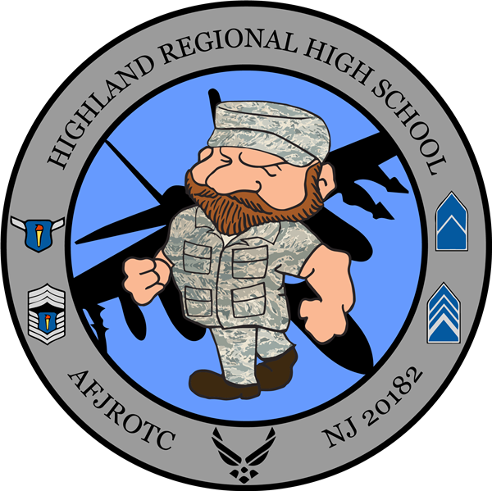
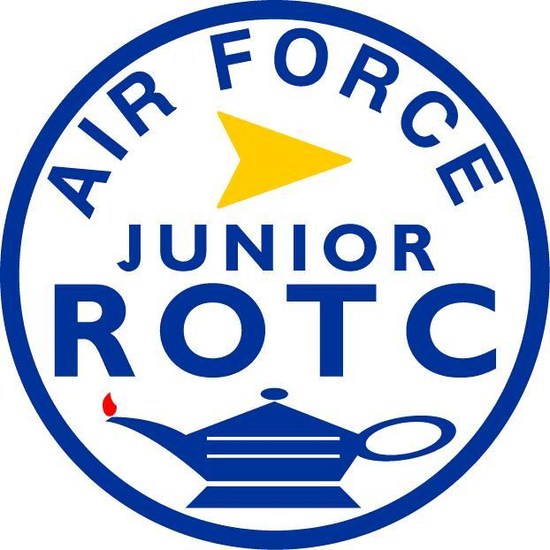
HIGHLAND REGIONAL HIGH SCHOOL
Air Force Junior Reserve Officer Training Corps

Slide 2

What Is Air Force JROTC
Mission
Core Values
Cadet Driven
In Class Education

Slide 3


Mission
Mission: “Develop citizens of character dedicated to serving their nation and community.”
Motto: “Building Better Citizens for America.”

Slide 4
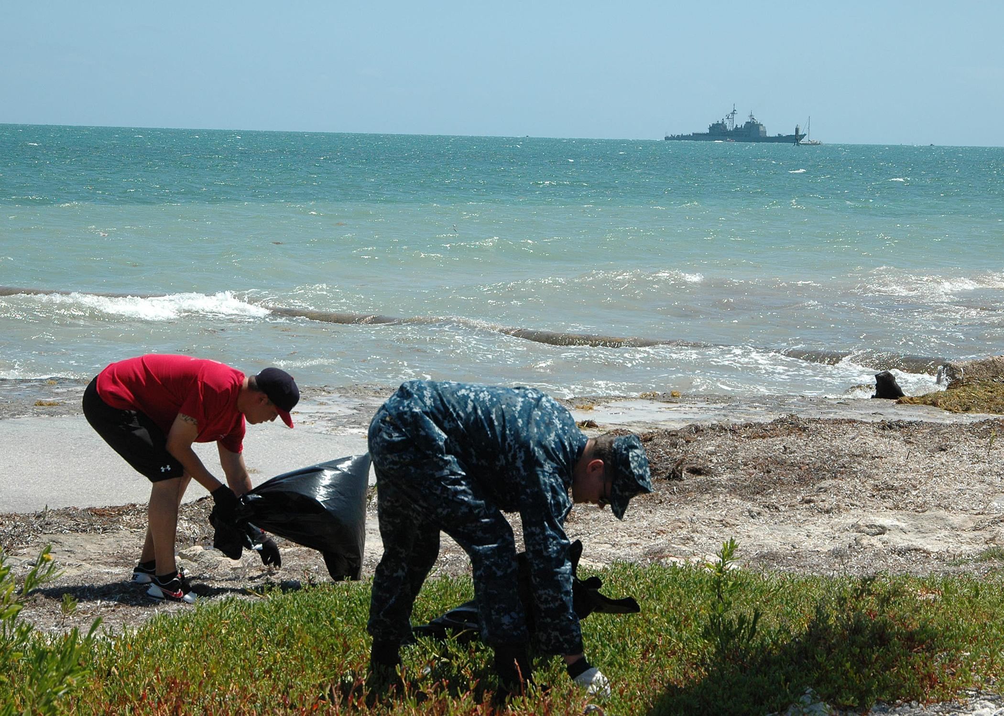


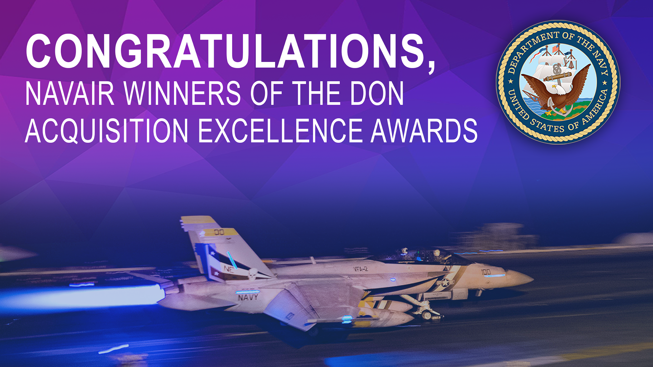
Core Values
Integrity First
Excellence In All We Do
Service before self

Slide 5
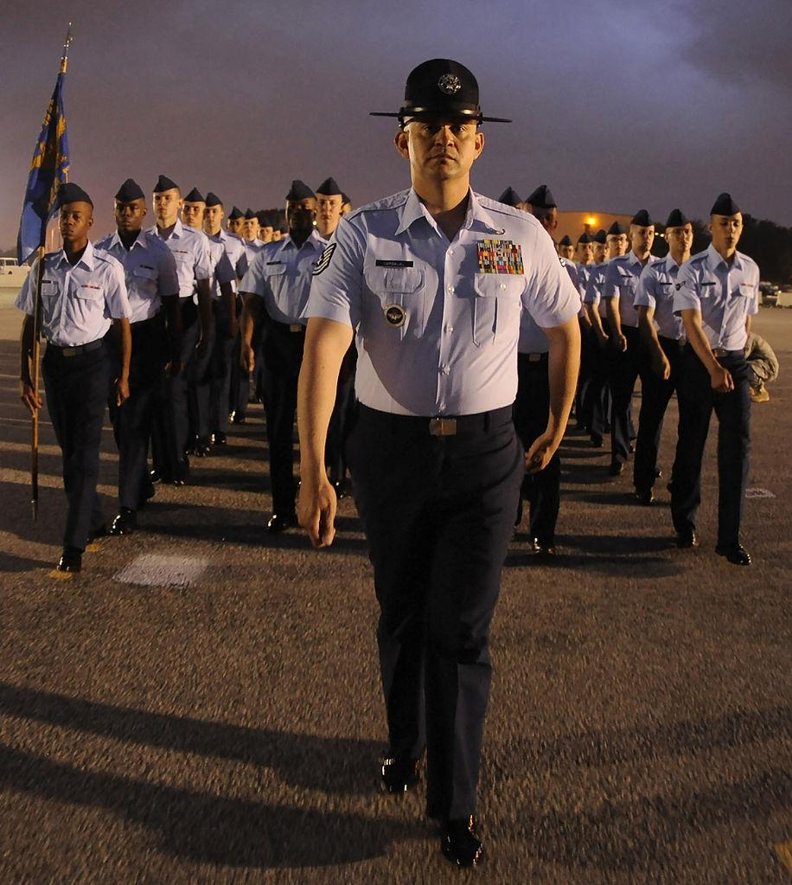
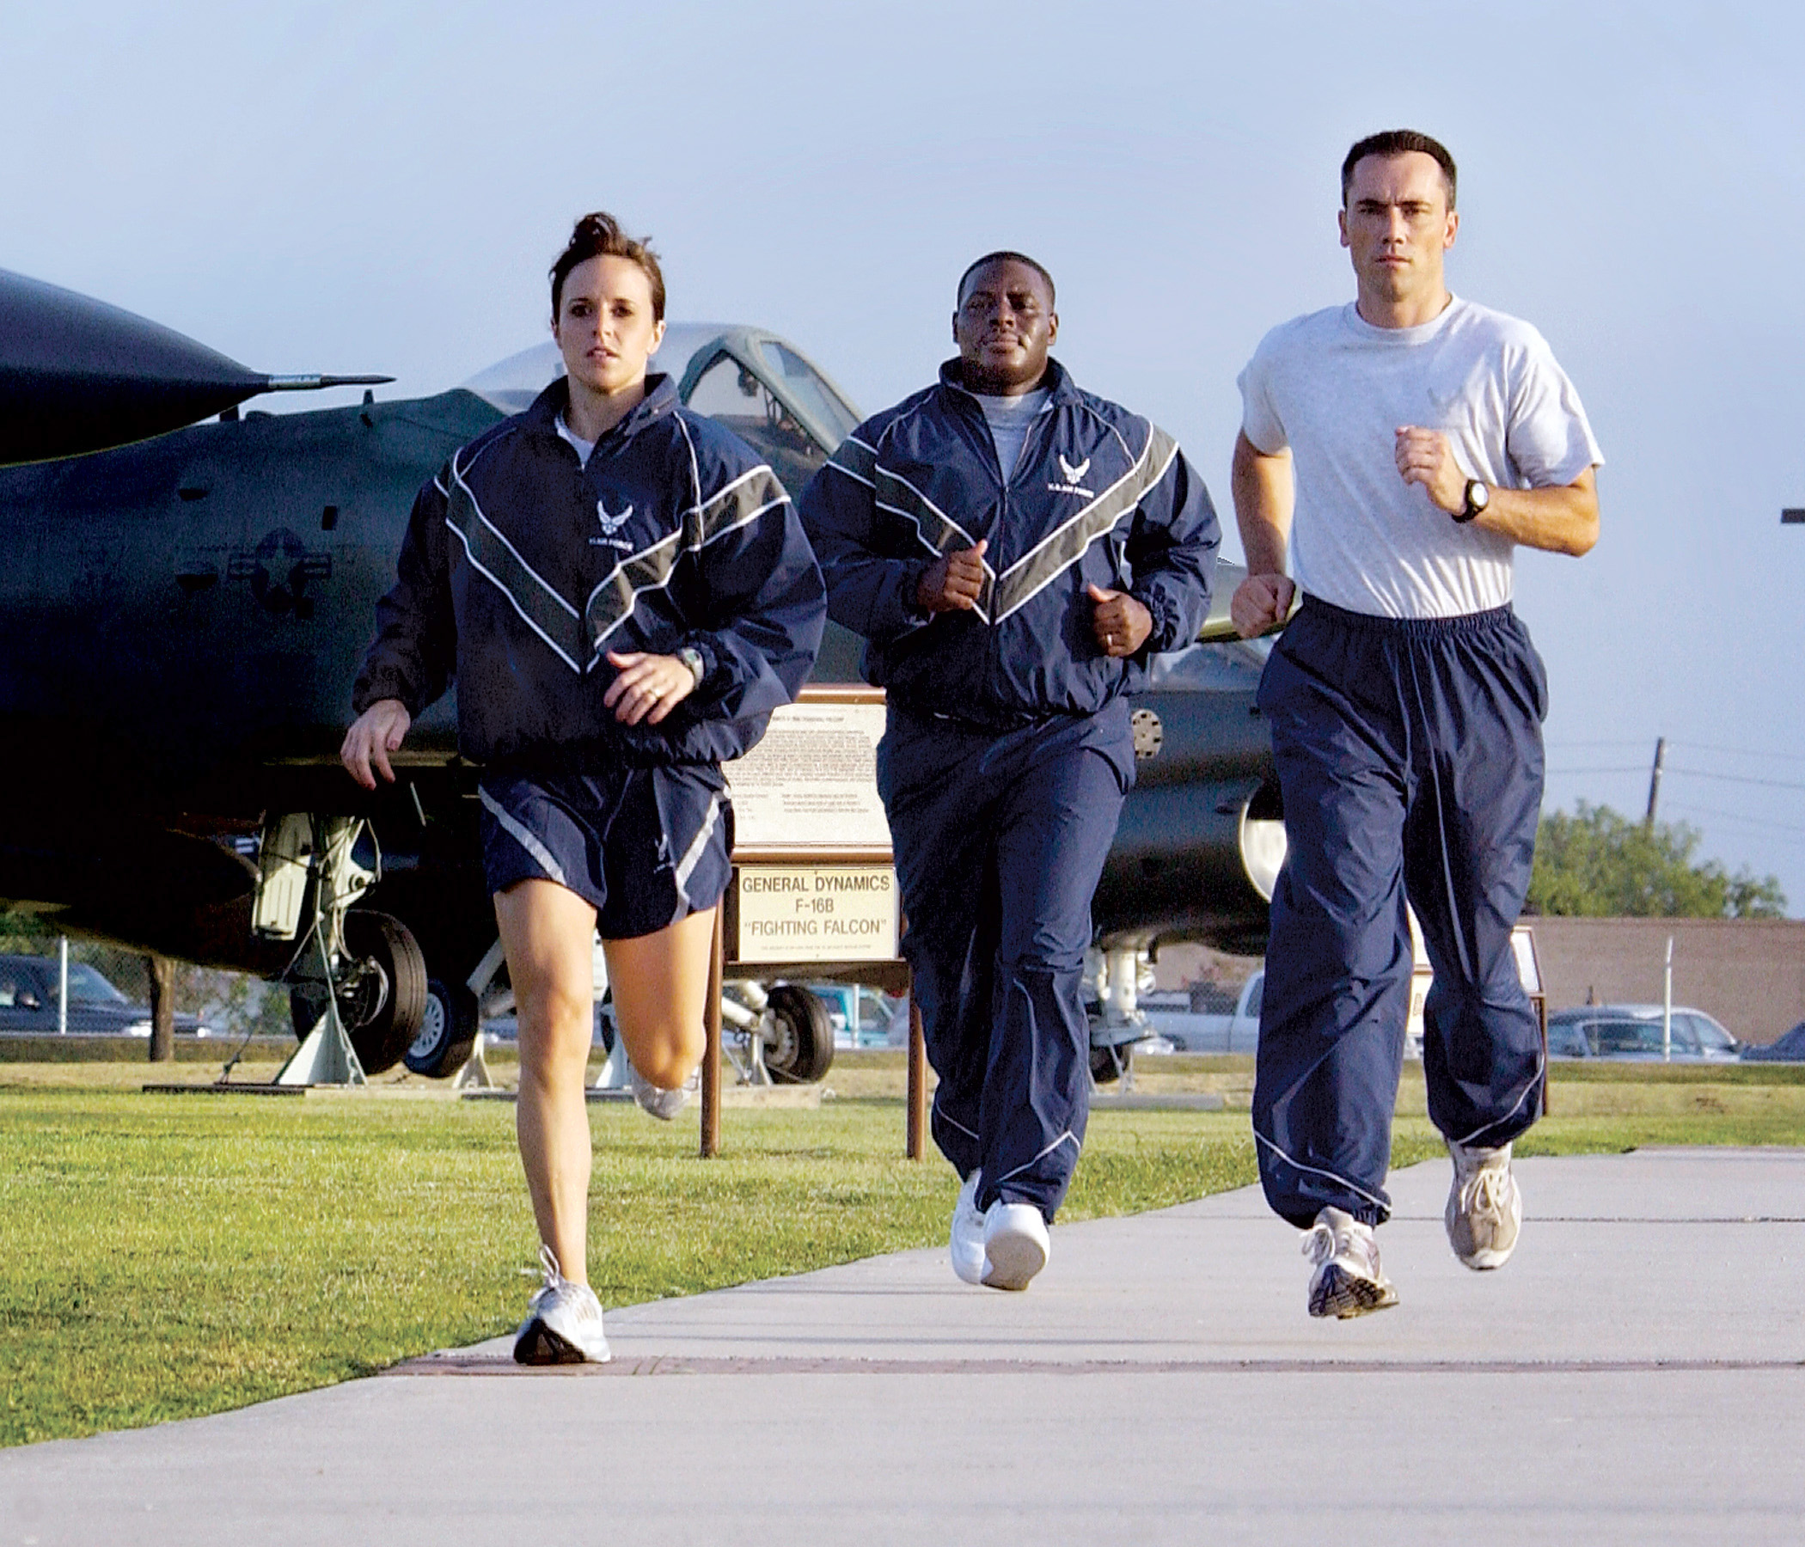

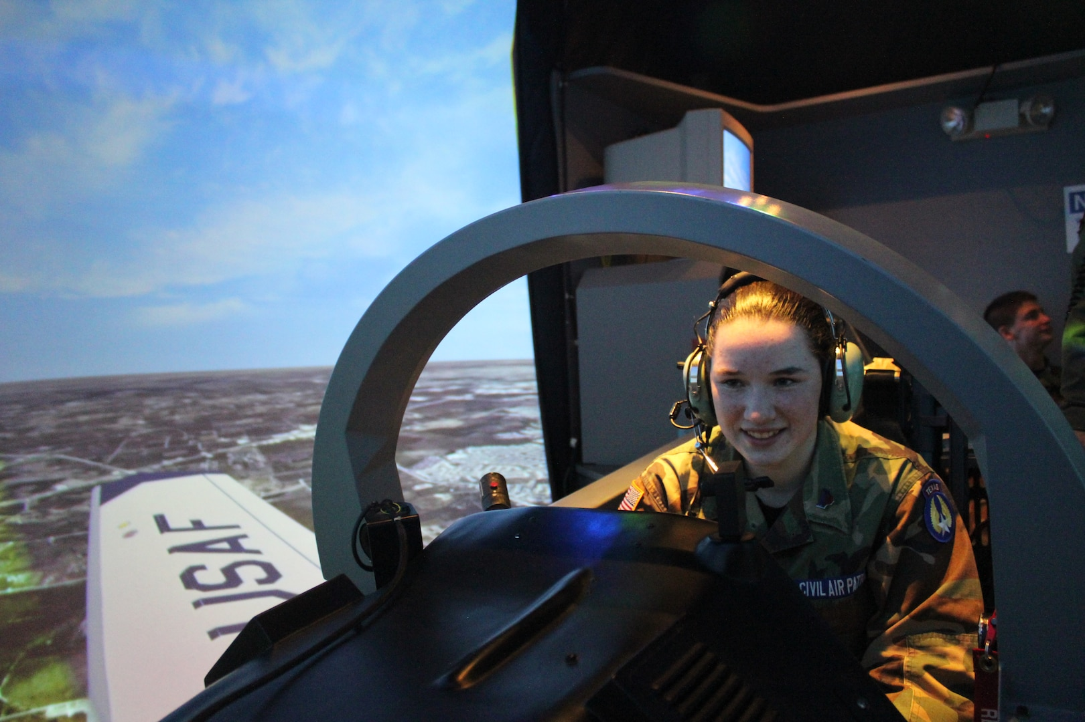
In-class Education
Leadership Education
Aerospace Education
Drill
PT/Wellness

Slide 6
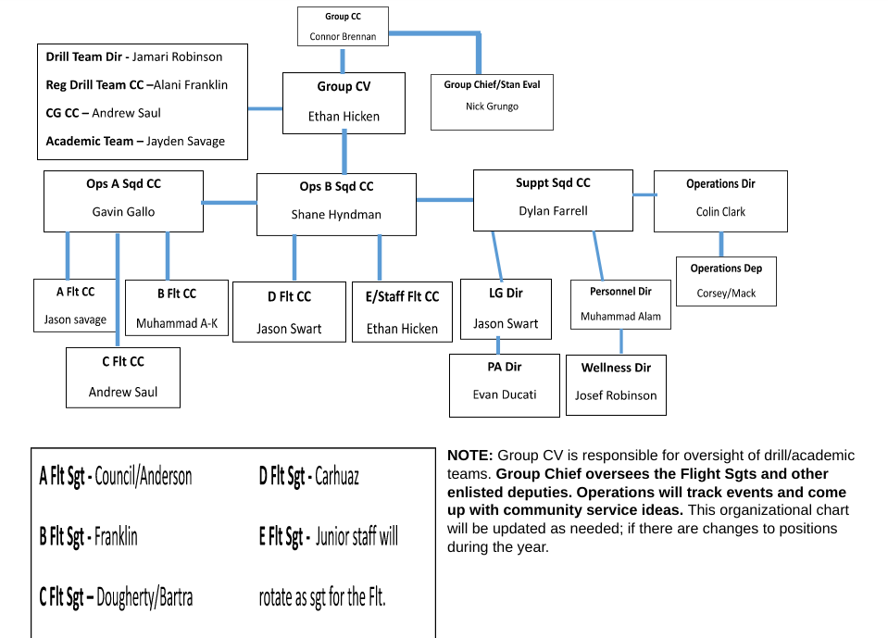
Cadet
Driven

Slide 7
After-School Activities
Drill
  Academic team
  Color Guard Team
  Inspection Team
  PT Team
  Regulation Drill Team
Drone Team
Cyberpatriot
Raiders
Kitty Hawk Air Society

Slide 8
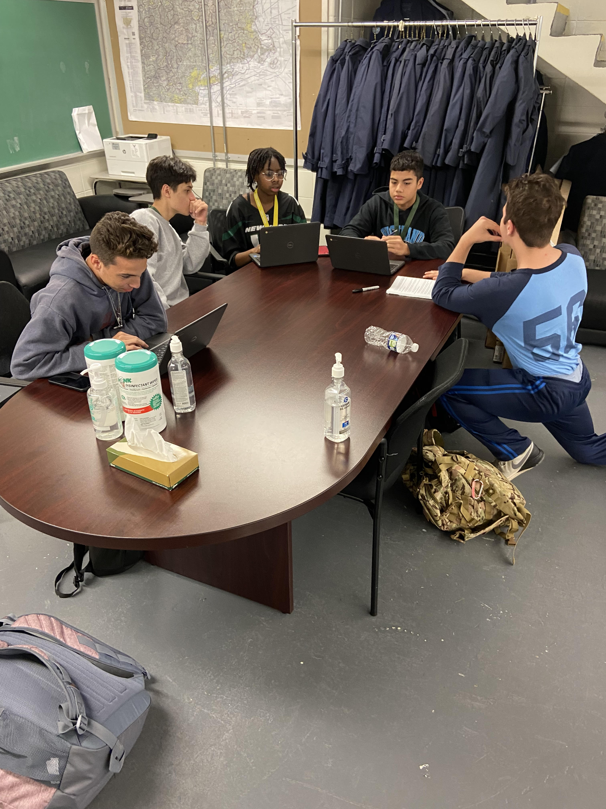
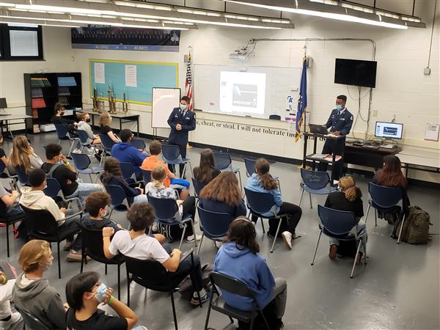
Academic Team

Slide 9
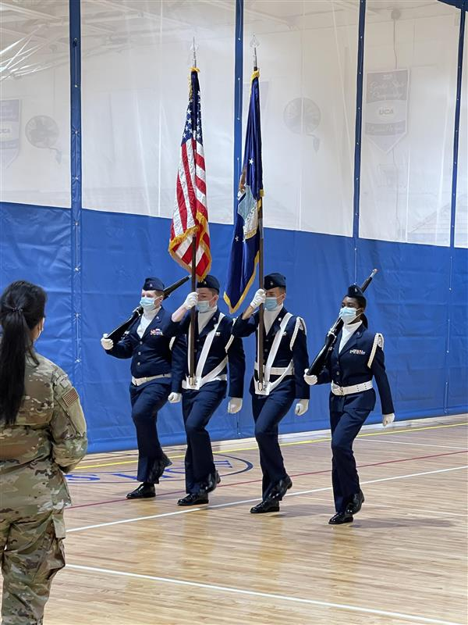
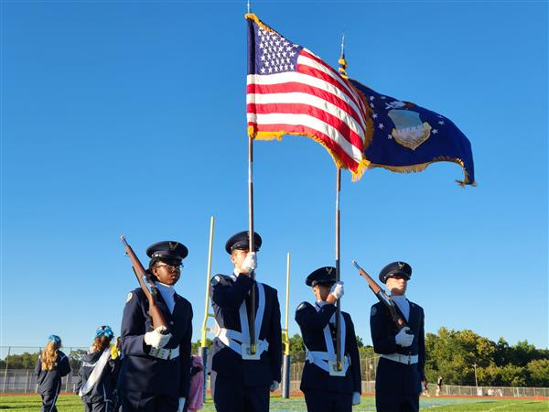
Color Guard

Slide 10
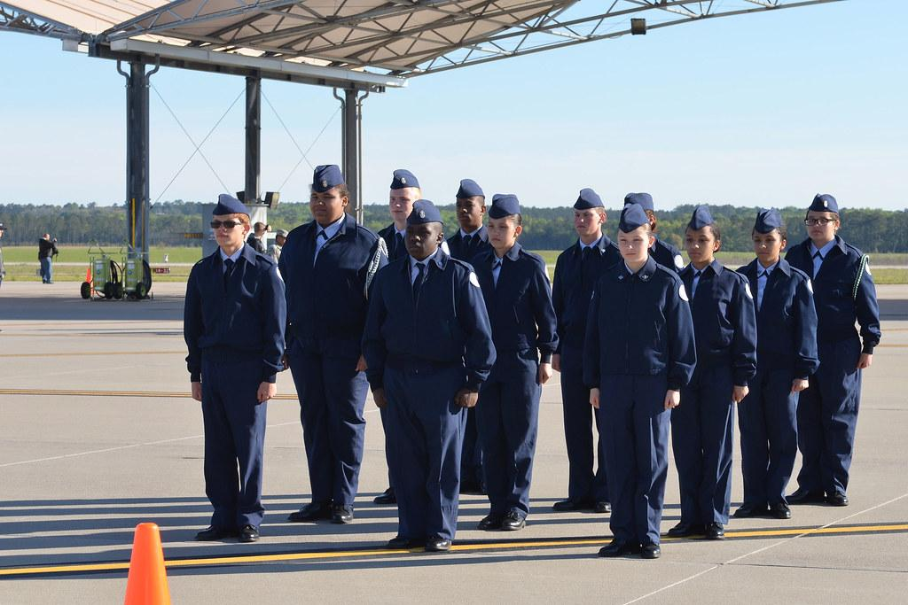
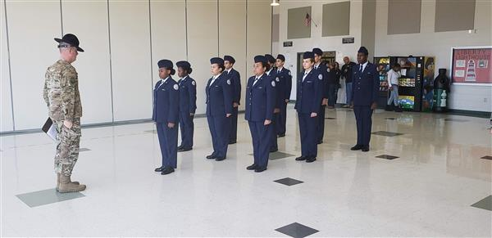
Inspection Team

Slide 11
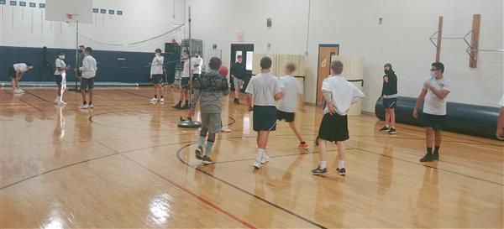
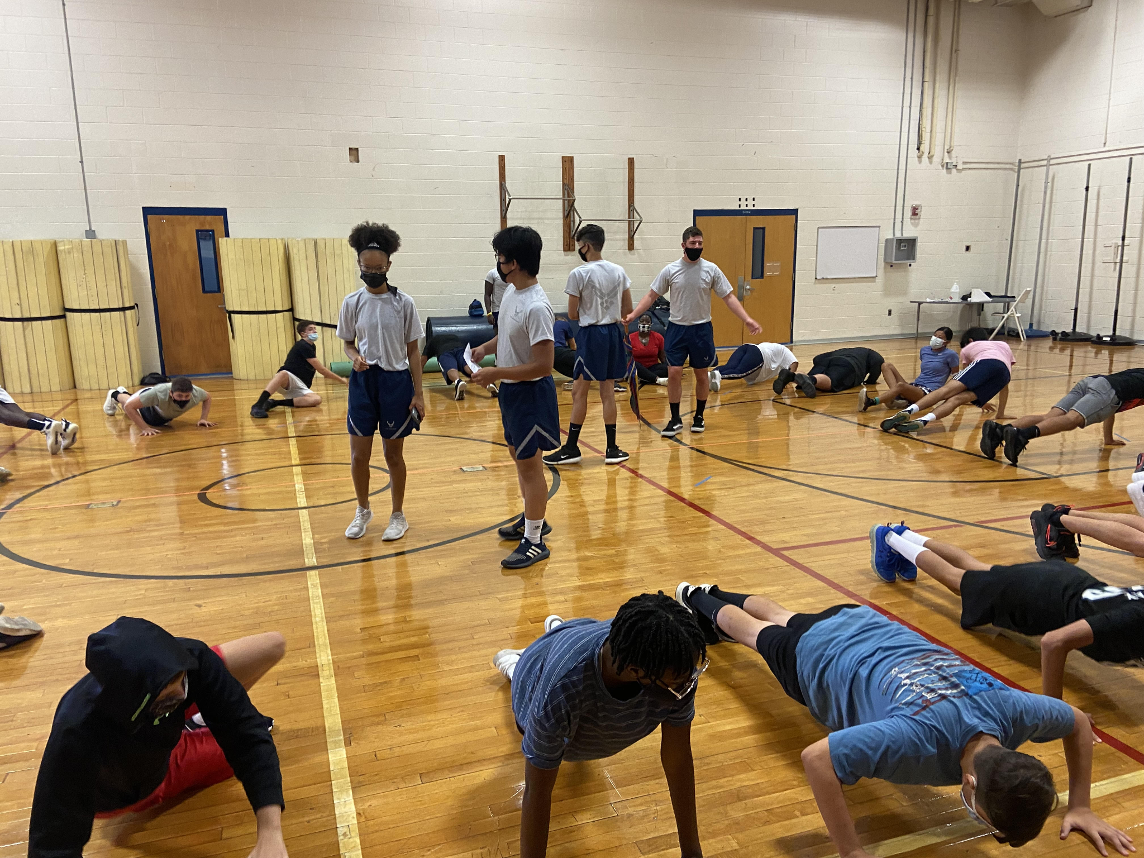
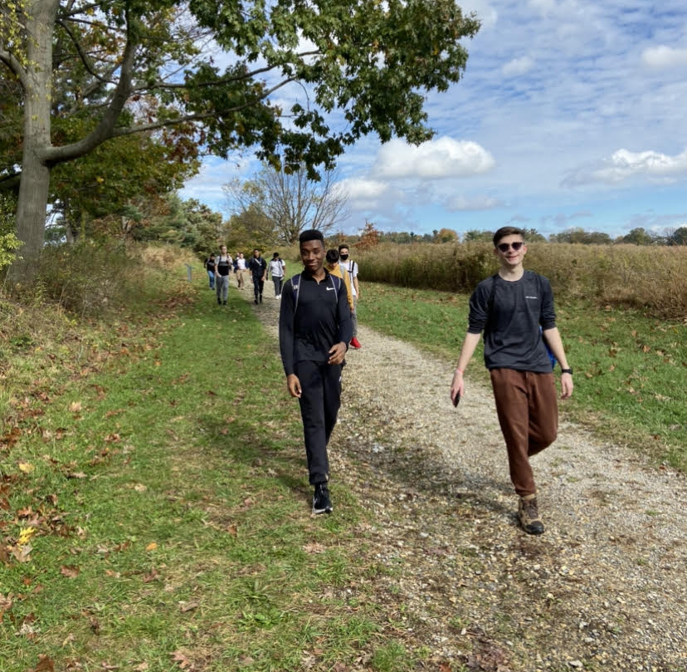
PT Team

Slide 12
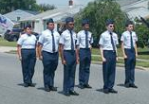
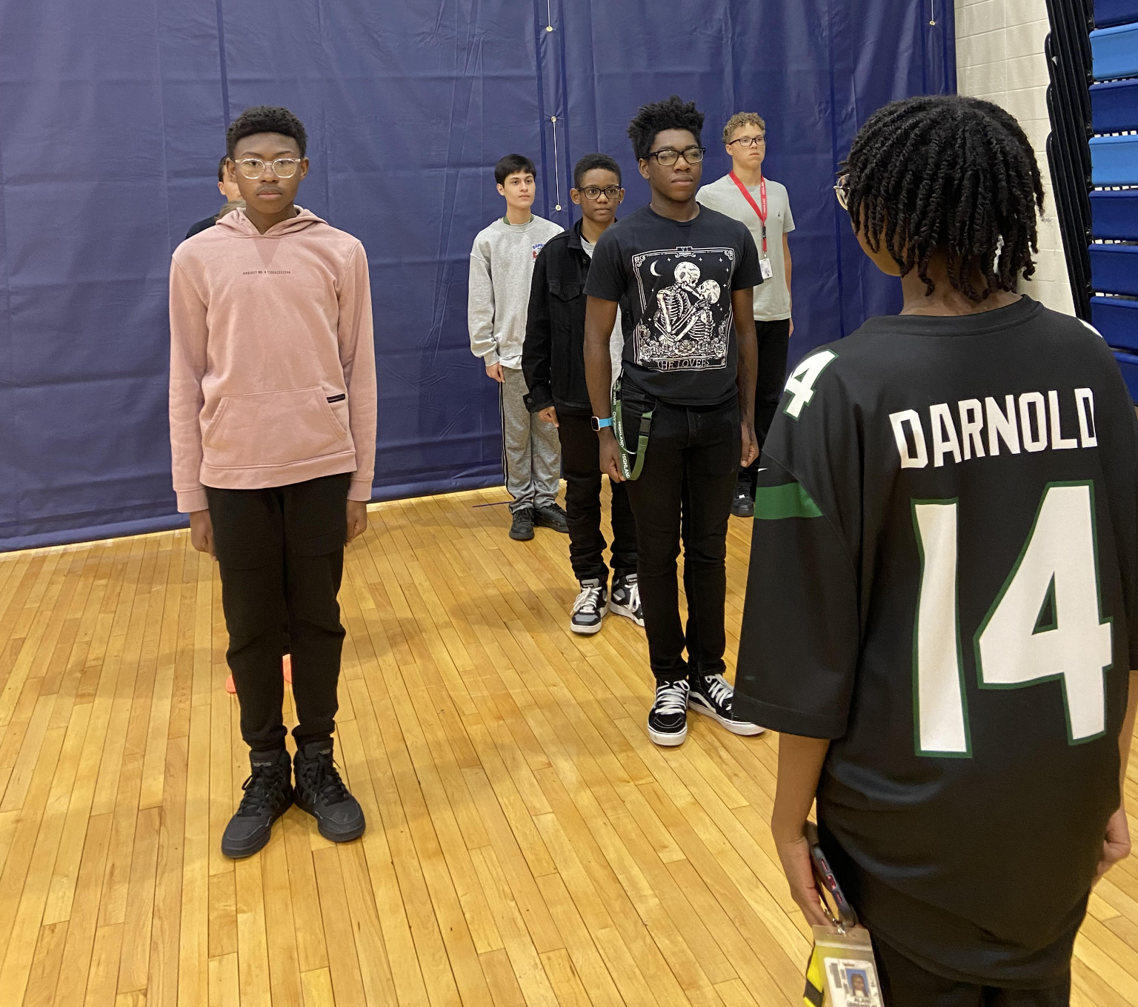
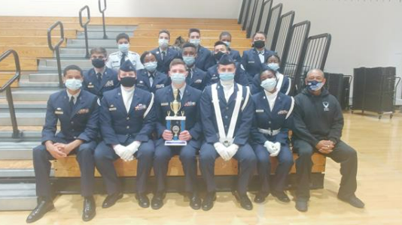
Regulation Drill

Slide 13
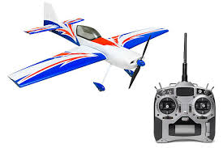
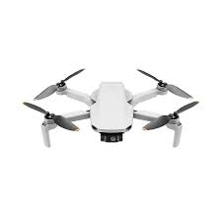

Drone Team

Slide 14
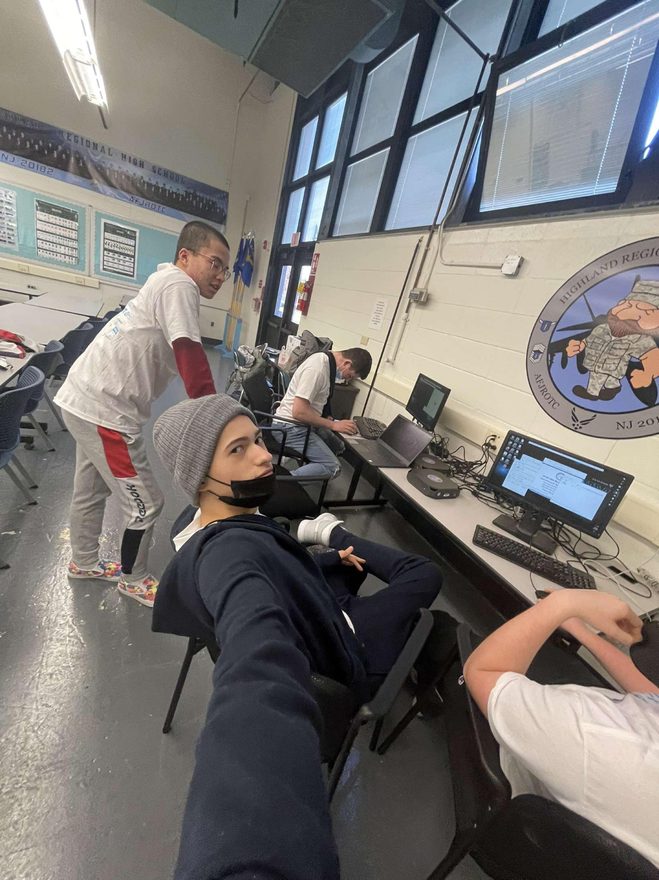
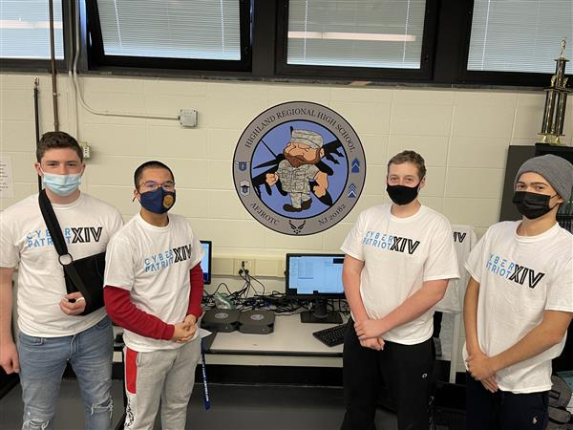
Cyberpatriot

Slide 15
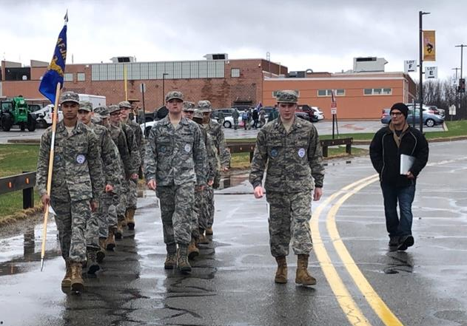
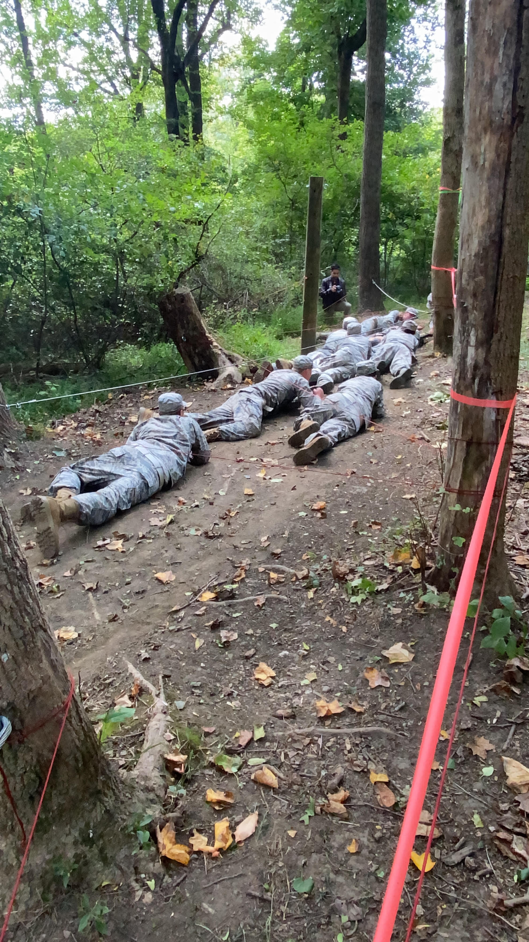
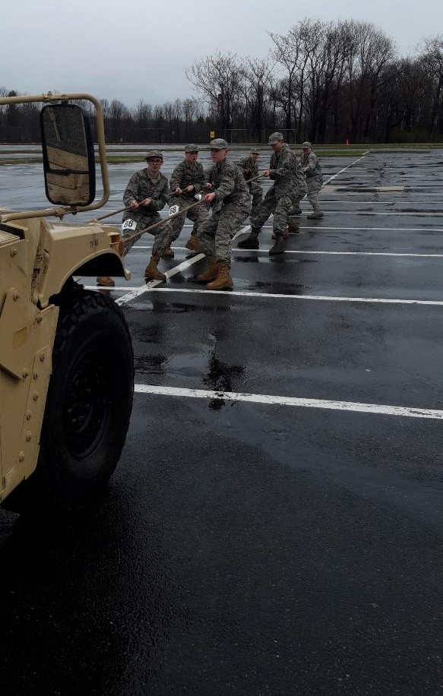
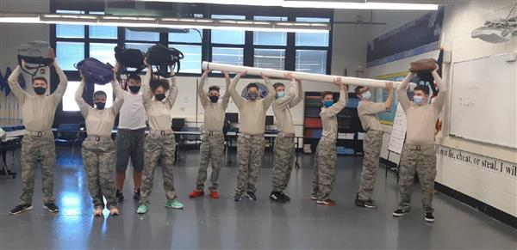
Raiders

Slide 16
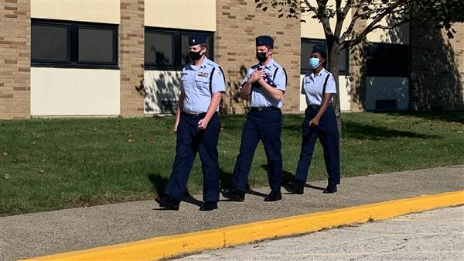
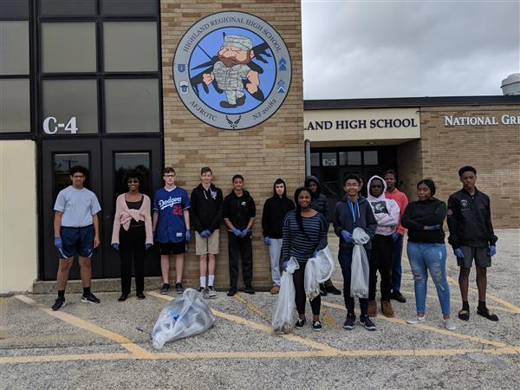
Kitty Hawk Air Society

Slide 17
My personal experience in jrotc
CADET swart (freshman)
CADET Saul (FRESHMAN)
CADET blake (freshman)

Slide 18
Post high school Accomplishments by cadets
FLIGHT SCHOLARSHIP TO EARN PRIVATE PILOTS LICENSE
ACCEPTANCE TO PRINCETON UNIVERSITY
ACCEPTANCE TO HARVARD UNIVERSITY
ACCEPTANCE TO GEORGE WASHINGTON UNIVERSITY
UNITED STATES AIR FORCE
UNITED STATES MARINE CORPS
CAPITOL HILL POLICE OFFICER
**AFJROTC HELPS YOU PREPARE FOR A SUCCESSFUL FUTURE**

Slide 19
Questions?

